Slide 1
CONDITIONAL STATEMENTS AND LOOPS {
forbeginners.html
workshop.css
<if,if-else,nested if etc,..>
}
Programming Language

Slide 2
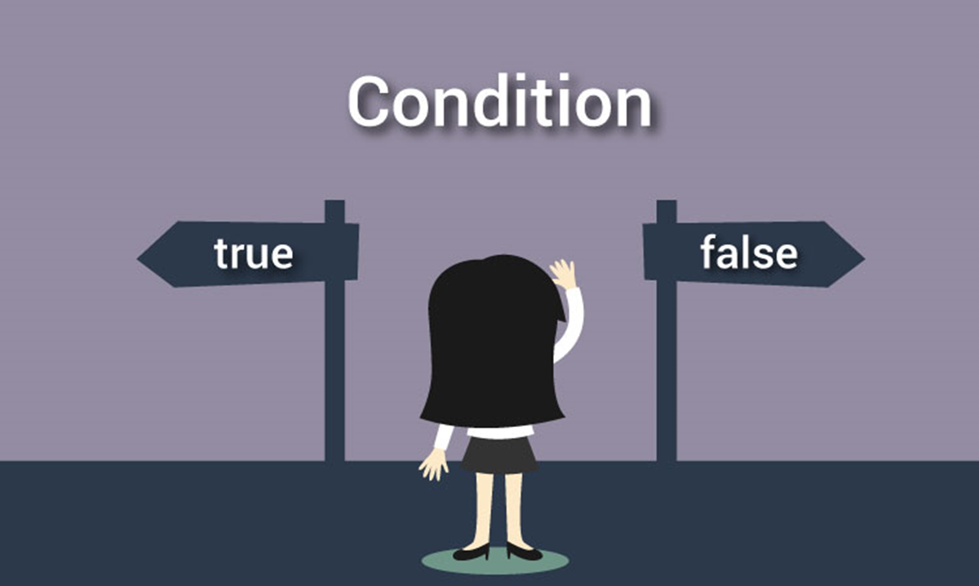
In programming, decision making is used to specify the order in which statements are executed
Programming Language

Slide 3
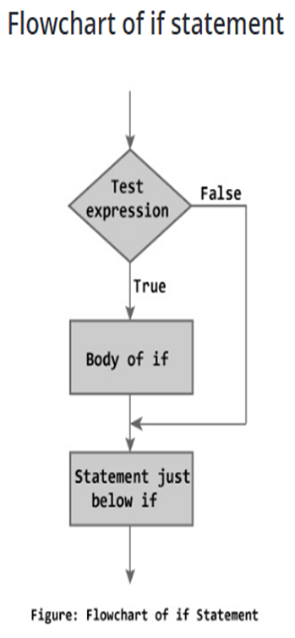
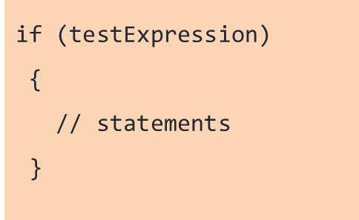
IF STATEMENT{
The if statement evaluates the test expression inside the parenthesis.
If the test expression is evaluated to true (nonzero), statements inside the body of if is executed.
If the test expression is evaluated to false (0), statements inside the body of if is skipped from execution.
}
Programming Language

Slide 4
IF STATEMENT
EXAMPLE:
int main()
{
int m=40,n=40;
if(m==n)
{
printf(“m and n are equal”);
}
}
Programming Language

Slide 5
IF ELSE STATEMENT
The if...else statement executes some code if the test expression is true (nonzero) and some other code if the test expression is false (0).
if (test Expression)
{
// codes inside the body of if
}
else
{
// codes inside the body of else
}
Programming Language

Slide 6
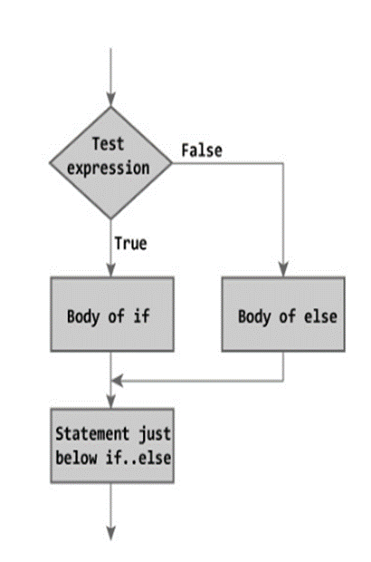
If test expression is true, codes inside the body of if statement is executed and, codes inside the body of else statement is skipped.
If test expression is false, codes inside the body of else statement is executed and, codes inside the body of if statement is skipped.
Programming Language

Slide 7
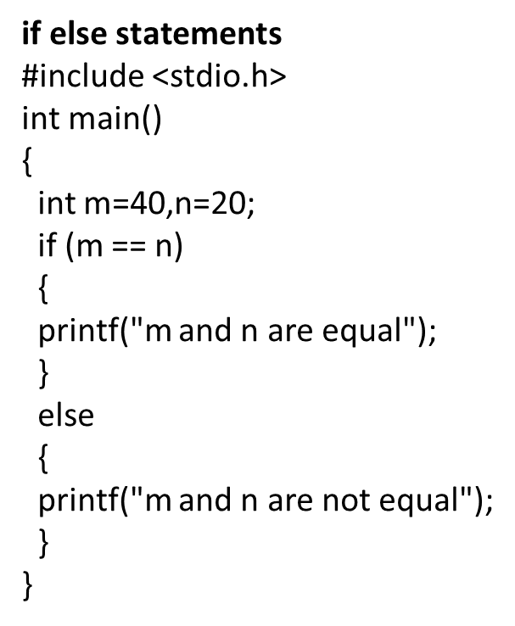
IF ELSE STATEMENT

Slide 8
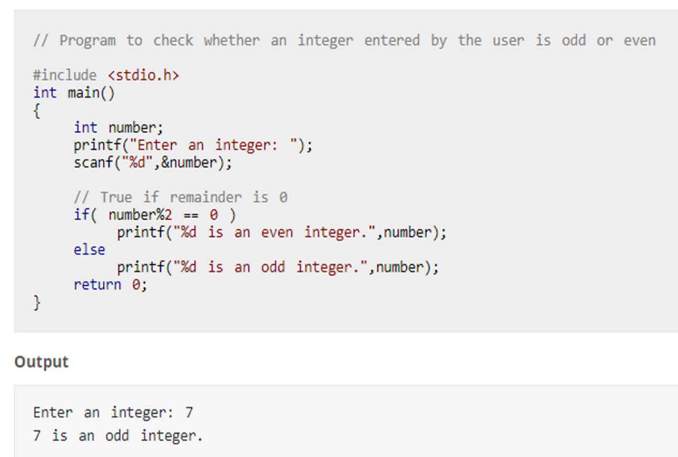
IF ELSE STATEMENT EXAMPLE

Slide 9
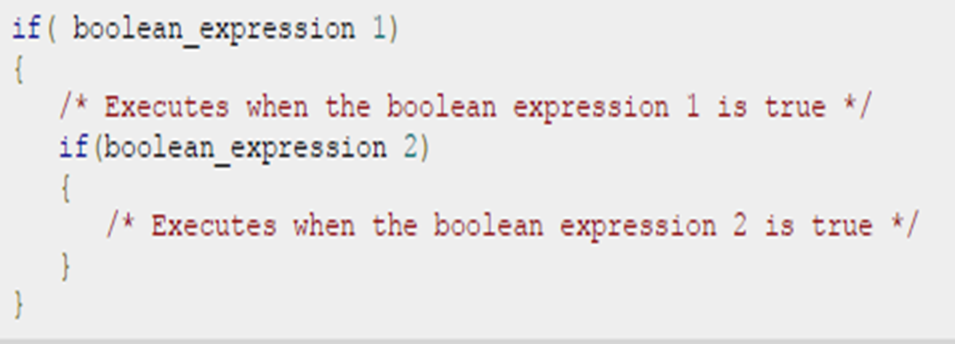
NESTED IF STATEMENTS
It is always legal in C programming to nest if-else statements, which means you can use one if or else if statement inside another if or else if statement(s).

Slide 10
EXAMPLE
#include <stdio.h> else{
Int main() { if (number == 0) {
int number; printf(“Number is zero.\n”);
printf(“Enter an integer: “); } else {
scanf(“%d” , &number); printf(“Number is negative.\n”);
if (number > 0) { }
if (number % 2 == 0){ }
printf(“The number is positive and even.\n”); }
} else {
printf(‘The number is positive and odd.\n”); return 0;
}
} }

Slide 11
IF..ELSE IF…ELSE STATEMENT
The ‘if-else if-else’ construct in C is used to test multiple conditions in sequence.

Slide 12
IF-ELSE IF-ELSE
#include <stdio.h>
int main() {
int number;
// Asking the user to enter an integer
printf("Enter an integer: ");
scanf("%d", &number);
// Using if-else if-else to check multiple conditions
if (number > 0) {
printf("The number is positive.\n");
} else if (number < 0) {
printf("The number is negative.\n");
} else {
printf("The number is zero.\n");
}
return 0;
}

Slide 13
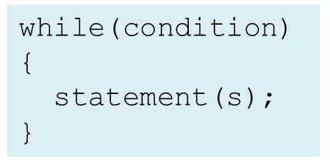
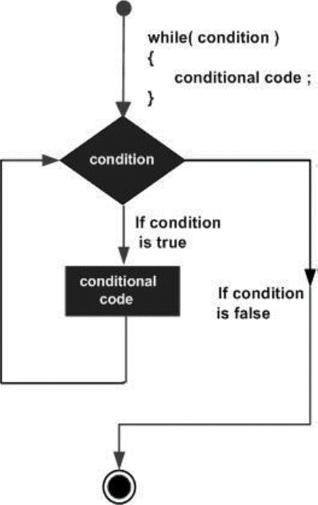
WHILE LOOP
Repeatedly executes a target statement as long as given condition is true.
Here, statement(s) may be a single statement or a block of statements. The condition may be any expression, and true is any nonzero value. The loop iterates while the condition is true.
When the condition becomes false, program control passes to the line immediately following the loop .

Slide 14
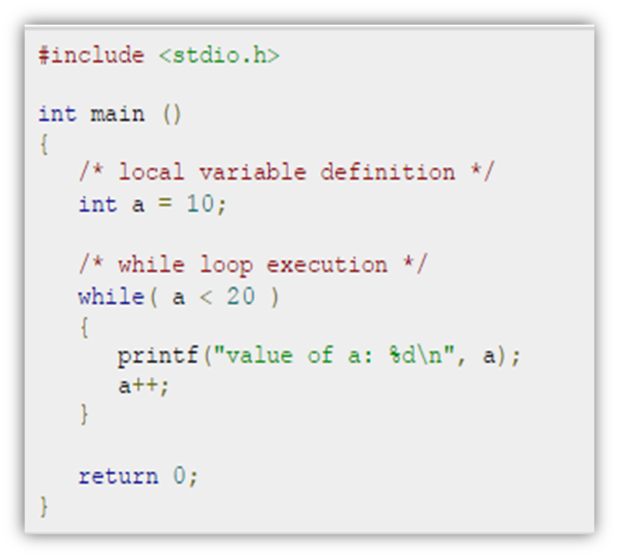
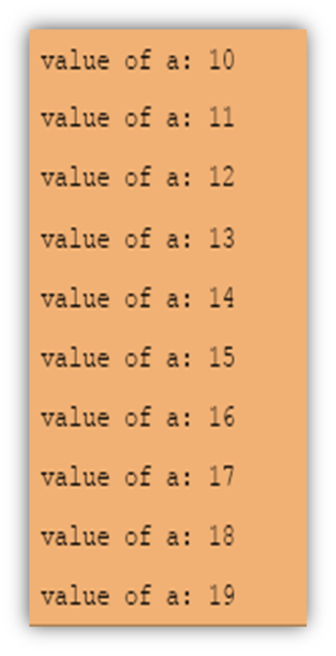

Slide 15
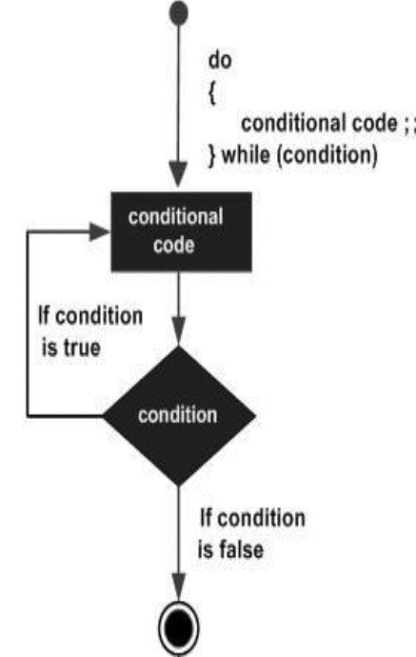
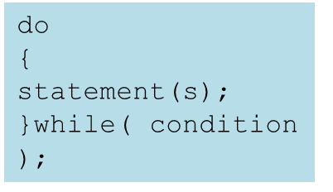
DO WHILE LOOP
Unlike for and while loops, which test the loop condition at the top of the loop, the do...while loop in C programming language checks its condition at the bottom of the loop.
A do...while loop is similar to a while loop, except that a do...while loop is guaranteed to execute at least one time.

Slide 16
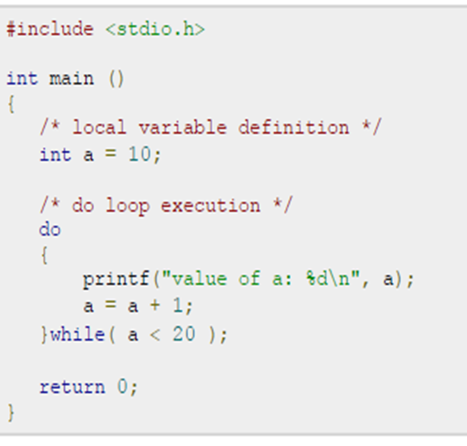
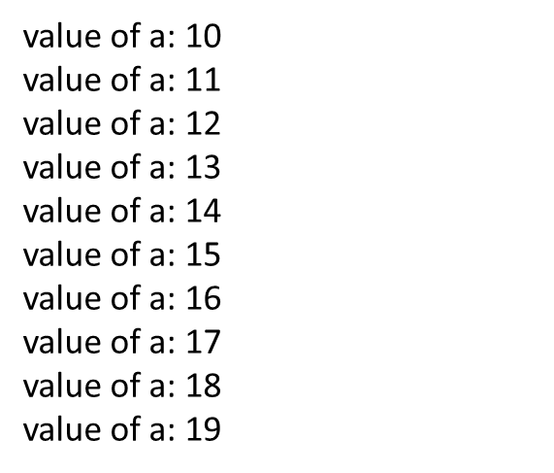
EXAMPLE

Slide 17
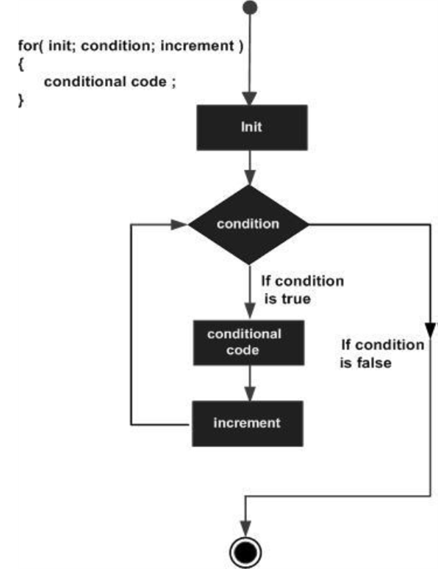
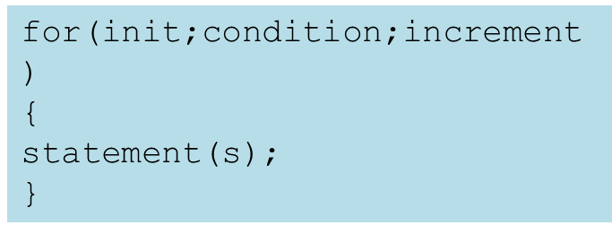
FOR LOOP IN C
A for loop is a repetition control structure that allows you to efficiently write a loop that needs to execute a specific number of times

Slide 18
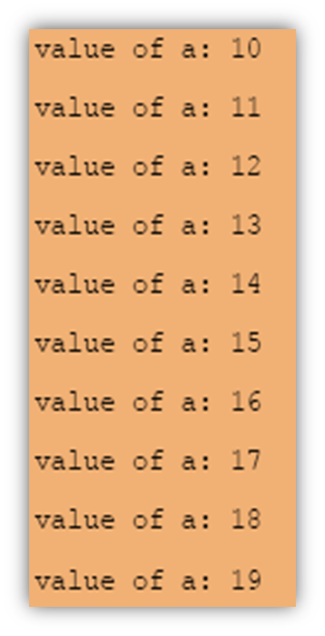
EXAMPLE
#include <stdio.h>
int main ()
{
/* for loop execution */
for( int a = 10; a < 20; a = a + 1 )
{
printf("value of a: %d\n", a);
}
return 0;
}

Slide 19
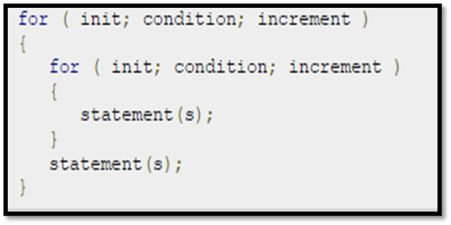
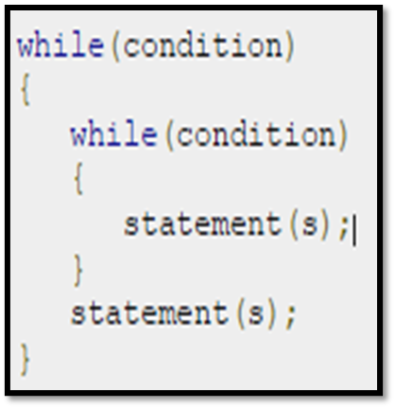
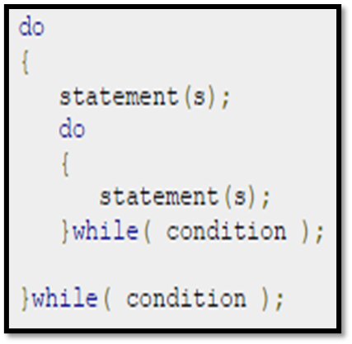
NESTED LOOPS IN C
Programming language allows to use one loop inside another loop. Following section shows few examples to illustrate the concept.

Slide 20
THE INFINITE LOOP
#include <stdio.h>
int main ()
{
for( ; ; )
{
printf("This loop will run forever.\n");
}
return 0;
}
#include <stdio.h>
int main ()
{
While(1)
{
printf("This loop will run forever.\n");
}
return 0;
}

Slide 21
GOTO STATEMENT
The ‘goto’ statement in C provides a way to jump to another point in the program.
#include <stdio.h> }
int main() addition:
{ printf(“%d”,sum);
int sum=0; return 0;
for(int i = 0; i<=10; i++) }
{
sum = sum+i;
if(i==5)
{
goto addition;
}

Slide 22
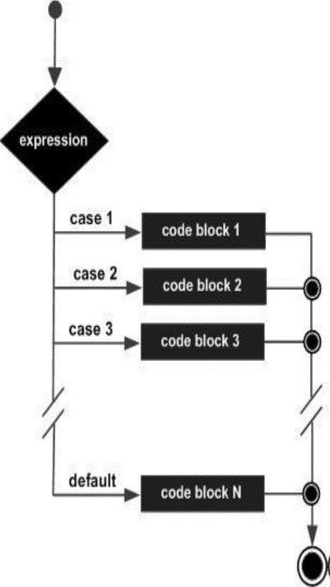
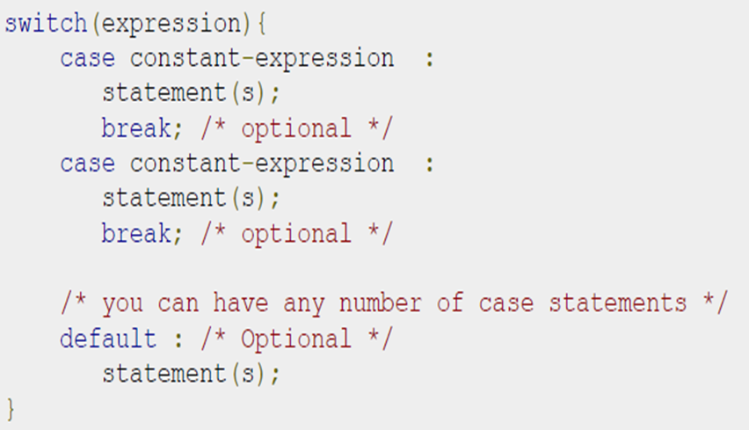
SWITCH STATEMENT
A switch statement allows a variable to be tested for equality against a list of values. Each value is called a case, and the variable being switched on is checked for each switch case.

Slide 23
SYNTAX
switch(variable)
{
case 1:
//execute your code
break;
case n:
//execute your code
break;
default:
//execute your code
break; }

Slide 24
EXAMPLE
#include<stdio.h> case 4:printf(“You chose
Int main() Four”);
{ break;
int a; case 5:printf(“You chose
printf("Please enter a no Five.”);
between 1 and 5: "); break;
scanf("%d",&a);
default:
switch(a) printf(“Invalid Choice.Enter
{ a number between 1 & 5”);
case 1: printf("You chose One"); break;
break; }
case 2: printf("You chose Two"); }
break;
case 3: printf("You chose Three");
break;

Slide 25
CONTINUE STATEMENT
The continue statement in C language is used to bring the program control to the beginning ofthe loop.
The continue statement skips some
lines of code inside the loop and continues with
the next iteration.
It is mainly used for a
condition so that we can skip some code for a
particular condition.

Slide 26
EXAMPLE
#include<stdio.h>
void main ()
{
int i = 0;
while(i!=10)
{
printf("%d", i);
continue;
i++;
}
}

Slide 27
EXAMPLE 2
#include<stdio.h>
int main()
{
int i=1; //initializing a local variable
//starting a loop from 1 to 10
for(i=1;i<=10;i++)
{
if(i==5)
{ //if value of i is equal to 5, it will continue the loop
continue;
}
printf("%d \n",i);
} //end of for loop
return 0;
}

